Slide 1


BidWiz: The Autonomous Proposal Architect.
Team Karkurleingy
Syed Wajdan Zeerak
Syed Zainish Fatima
hadia Naveed
1

Slide 2
Problem Statement
  The Billion-Dollar Copy-Paste Problem
  Enterprise sales teams spend 30-40% of their time manually answering RFP questionnaires1.
  The Cost: Billions lost in productivity and missed deadlines.
  The Gap: Current tools are just "Search Engines." They don't do the work.
2

Slide 3
Proposed Solution
Meet BidWiz: The Autonomous Proposal Architect.
Input: Upload a raw PDF (Knowledge Base).
Process: The AI reasons, drafts, reviews, and formats.
Output: A professional, timestamped PDF emailed directly to the stakeholder.
Metric: "Reduces Time-to-Draft from 3 days to 30 minutes
3

Slide 4
Under the Hood
    Frontend: React + TypeScript for Enterprise reliability.
    Inference: Groq LPU integration for real-time token generation (Speed).
    RAG: Local FAISS embeddings for data privacy (Security)3.
    Automation: Python ReportLab + SMTP for physical artifact generation.
4

Slide 5
Market & Business Viability
A $3.1 Billion Market Opportunity.
TAM (Total Addressable Market): $3.1 Billion Proposal Software Market4.
Target Users: Enterprise Sales Teams, Government Contractors, and Software Houses555555555.
Business Model: Tiered SaaS (Freemium for startups, Per-Seat License for Enterprise).
5

Slide 6
Competitive Advantage
  vs. Manual: 90% Faster6.
  vs. Legacy Software: We use Cognition (Reasoning), not just Keywords7.
  vs. Generic AI: We solve "Hallucination" via a Critic Agent Loop (The self-correction mechanism)8.
6

Slide 7
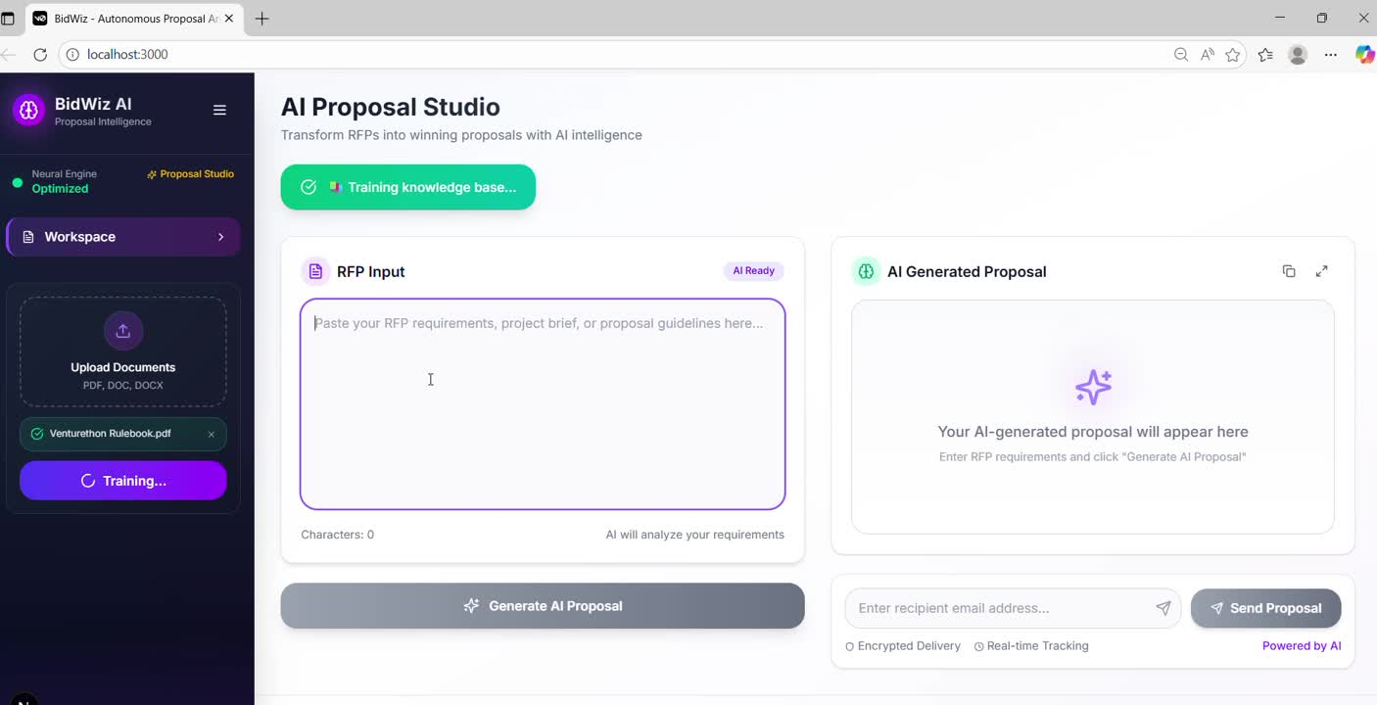
Live Demo
7

Slide 8
Thank you
8

